Slide 1
Spike Milligan
BY
Shane
Emma
Maeve

Slide 2
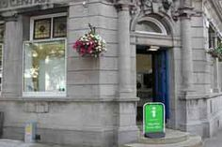
Spike Milligan
We decided to focus on Spike Milligan. We learnt about him when we went on our tour of Sligo. John was our tour guide. We met him at the Tourist Information Office. It is located at the top of O’Connell street. We started or tour at 11.00AM.

Slide 3
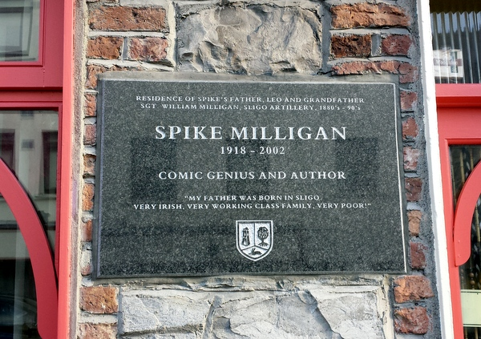
Where is Spike Milligan’s Plaque located ?
We left the Tourist Information Office then went to W.B Yeats's statue. Then we took a left on Holburn street and the plaque was on the right.

Slide 4
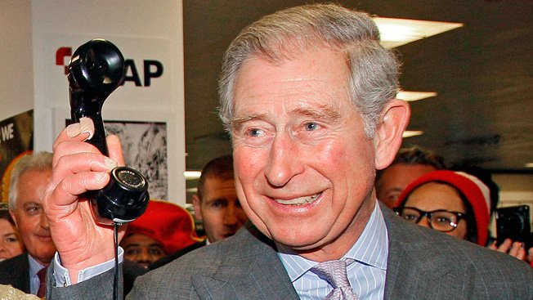
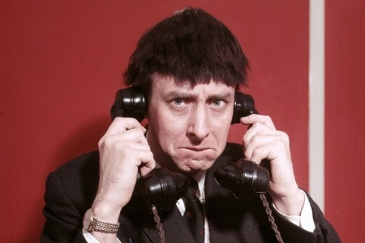
Spike Milligan and Prince Charles
Spike Milligan was a famous comedian. We heard he was funny and a friend of Prince Charles . There is a story about Spike and Prince Charles . Spike was looking for a passport he rang an office over in England they said ‘ya ya ya we will give you a passport but you have to pledge allegiance to the Queen of England’ Spike said ‘I don’t think I can do that’. The next day he got a call from Prince Charles saying you need to pledge allegiance to the queen.Spike said ‘well she’s your mum!’. That’s when Spike and Prince Charles became friends.
HAHAHAHA
Well
She’s
Your
Mum

Slide 5
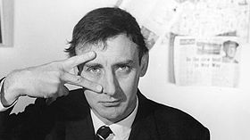
Spike Milligan facts
He had 6 kids.Jane,Laura,Sean,Sile,James and Romany
His father was born on Holborn street
He fought in World War 2
His rank was gunner
He died on the 27th of February 2002
He died because of a kidney failure

Slide 6
The End
THANKS FOR
WATCHING
BY
SHANE, EMMA AND MAEVE

