Slide 1
Spike milligAn
By Adam, Katie and Lauren

Slide 2
Spike milliGAn
Was an Anglo-irish comedian, writer, musician, poet, playwright, soldier and actor.
Milligan was the main writer and a cast member of The Goon show.

Slide 3
SPIKE MILLIGAN
Spike Milligan was the son of an Irish father and an English mother. His early life was spent in India where he was born.

Slide 4
SPIKE MILLIGANS LIFE
Spike Milligan was born on April 16, 1918, in Ahmednagar, India. Raised in British India, he moved to England as a teenager.
After serving in World War 2.He and a friend entertained the troops with funny acts.
Others joined, and the BBC began broadcasting his troupe's work on the 1950s radio hit The Goon Show. He also acted on stage and in film, and wrote books of poetry, war memoirs and a play. Milligan died in 2002.

Slide 5
poetry
On the ning nang nong Where the Cows go Bong! and the monkeys all say BOO! There's a Nong Nang Ning Where the trees go Ping! And the tea pots jibber jabber joo. On the Nong Ning Nang All the mice go Clang And you just can't catch 'em when they do! So its Ning Nang Nong Cows go Bong! Nong Nang Ning Trees go ping Nong Ning Nang The mice go Clang What a noisy place to belong is the Ning Nang Ning Nang Nong!!

Slide 6
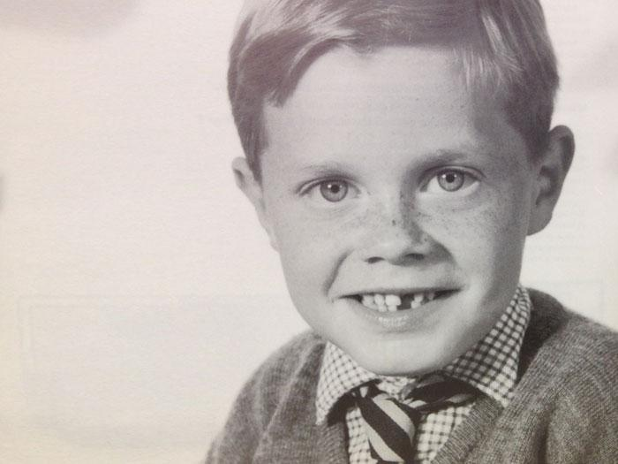
SPIKE MILLAGAN AS A CHILD
This is a picture of Spike Milligan as a young boy. He is 10 years old in this picture

Slide 7
Hope You enjoyed
THE END

